Slide 1
UNIT-4
UNICAST ROUTING

Slide 2
GENERAL IDEA
If a datagram is destined for only one destination (one-to-one delivery) - unicast routing.
If the datagram is destined for several destinations (one-to-many delivery) - multicast routing.
If the datagram is supposed to be delivered to all hosts in the internet (one-to-all) - broadcast
routing.

Slide 3
An Internet as a Graph
To find the best route, an internet can be modeled as a graph.
A graph in computer science is a set of nodes and edges (lines) that connect the nodes.
To model an internet as a graph, each router as a node and each network between a pair of routers as an edge.
An internet is, in fact, modeled as a weighted graph

Slide 4
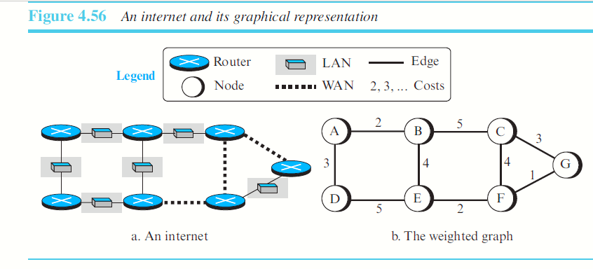

Slide 5
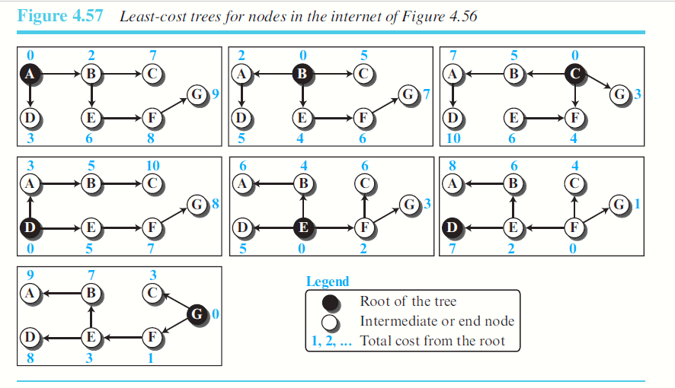

Slide 6
Distance Vector Routing
Completely decentralized.
No node has complete information about the costs of all network links.
Gradual calculation of path by exchanging information with neighbors.
Each node constructs a one-dimensional array containing the “distances” or “costs” to all other nodes and distributes it to its immediate neighbors.
Key thing -- each node knows the cost of links to its neighbors.
If no link exists between two nodes, the cost of a direct link between the nodes is “infinity”.

Slide 7
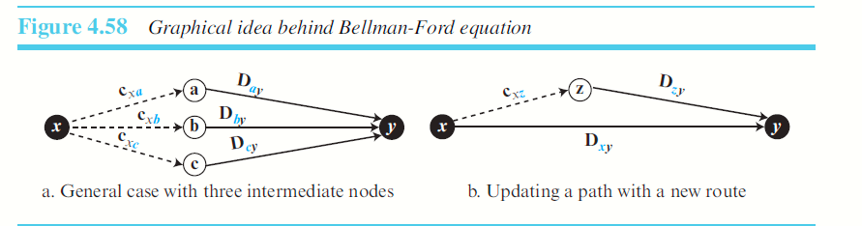
The heart of distance-vector routing is the famous Bellman-Ford equation.
The following shows the general case in which Dij is the shortest distance and cij is the cost between node i and j.

Slide 8
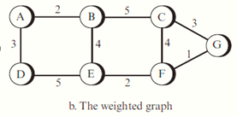
A
A | 0
B | 2
C | ∞
D | 3
E | ∞
F | ∞
G | ∞
F
A | ∞
B | ∞
C | 4
D | ∞
E | 2
F | 0
G | 1
G
A | ∞
B | ∞
C | 3
D | ∞
E | ∞
F | 1
G | 0
B
A | 2
B | 0
C | 5
D | ∞
E | 4
F | ∞
G | ∞
C
A | ∞
B | 5
C | 0
D | ∞
E
F | 4
G | 3
D
A | 3
B | ∞
C | ∞
D | 0
E | 5
F | ∞
G | ∞
E
A | ∞
B | 4
C | ∞
D | 5
E | 0
F | 2
G | ∞

Slide 9
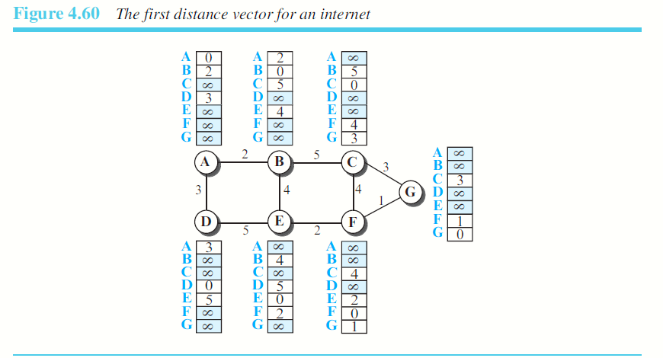
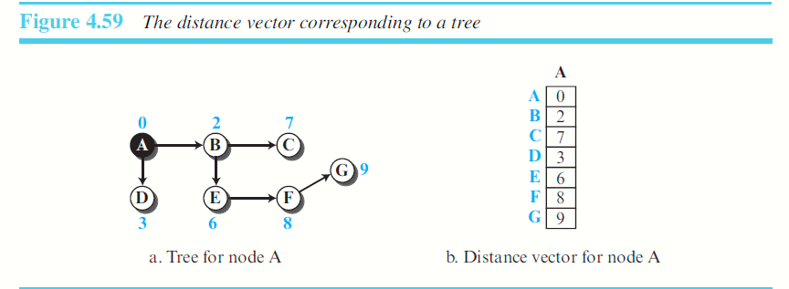

Slide 10
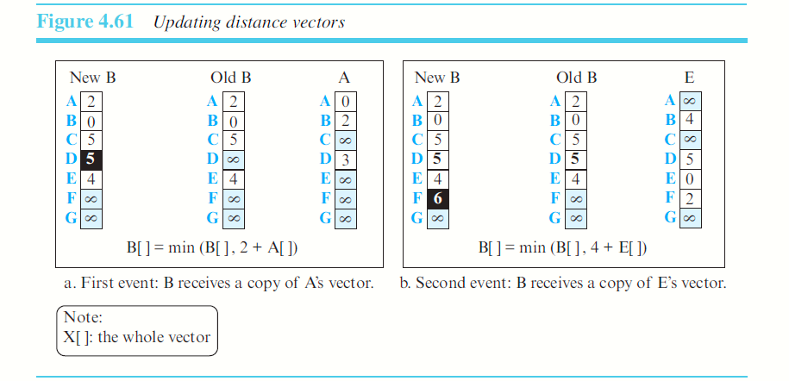
E
A | ∞
B | 4
C | ∞
D | 5
E | 0
F | 2
G | ∞
C
A | ∞
B | 5
C | 0
D | ∞
E | ∞
F | 4
G | 3

Slide 11
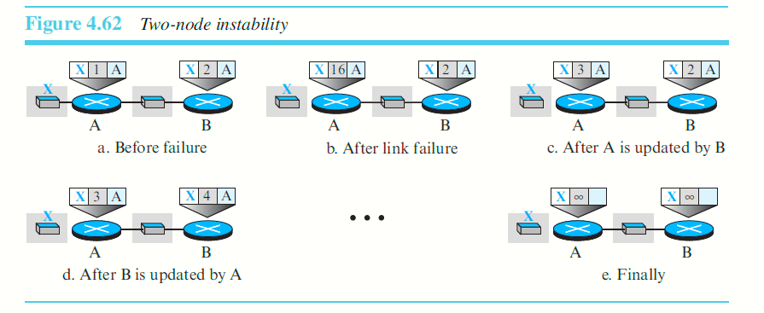
COUNT TO INFINITY PROBLEM

Slide 12
An Example
 | A | B | C | D | E | F | G
A | 0 | 1 | 1 | ∞ | 1 | 1 | ∞
B | 1 | 0 | 1 | ∞ | ∞ | ∞ | ∞
C | 1 | 1 | 0 | 1 | ∞ | ∞ | ∞
D | ∞ | ∞ | 1 | 0 | ∞ | ∞ | 1
E | 1 | ∞ | ∞ | ∞ | 0 | ∞ | ∞
F | 1 | ∞ | ∞ | ∞ | ∞ | 0 | 1
G | ∞ | ∞ | ∞ | 1 | ∞ | 1 | 0
Internal Information at each node ----->

Slide 13
Routing Tables
 | Cost | Next Hop
B | 1 | B
C | 1 | C
D | ∞ | -
E | 1 | E
F | 1 | F
G | ∞ | -
With this information, routing table at A is -->

Slide 14
Evolution of the table.
Each node sends a message to neighbors with a list of distances.
F --> A with G is at a distance 1
C --> A with D at distance 1.
 | Cost | Next Hop
B | 1 | B
C | 1 | C
D | 2 | C
E | 1 | E
F | 1 | F
G | 2 | F

Slide 15
Final Distance Matrix
 | A | B | C | D | E | F | G
A | 0 | 1 | 1 | 2 | 1 | 1 | 2
B | 1 | 0 | 1 | 2 | 2 | 2 | 3
C | 1 | 1 | 0 | 1 | 2 | 2 | 2
D | 2 | 2 | 1 | 0 | 3 | 2 | 1
E | 1 | 2 | 2 | 3 | 0 | 2 | 3
F | 1 | 2 | 2 | 2 | 2 | 0 | 1
G | 2 | 3 | 2 | 1 | 3 | 1 | 0

Slide 16
LINK STATE ROUTING
The cost associated with an edge defines the state of the link.
Links with lower costs are preferred to links with higher costs; if the cost of a link is infinity, it means that the link does not exist or has been broken.

Slide 17
Link-State Database (LSDB)
To create a least-cost tree with this method, each node needs to have a complete map of
the network, which means it needs to know
the state of each link.
The collection of states for all links is called the link-state database (LSDB)

Slide 18
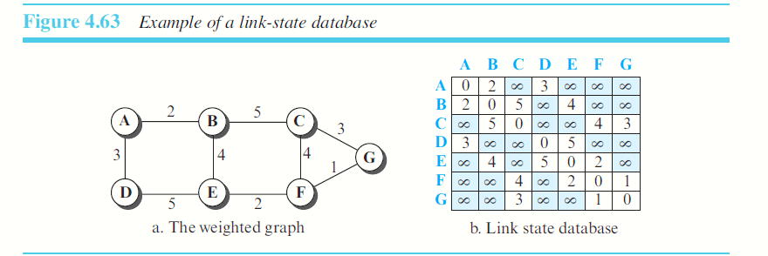

Slide 19
How does each node create this LSDB that contains information about the whole internet?
Flooding
Each node can send some greeting messages to all its immediate neighbors.
Two pieces of information for each neighboring node: (LS packet - LSP)
The identity of the node
The cost of the link

Slide 20
LSP
LSP is sent out of each interface.
When a node receives an LSP from one of its interfaces, it compares the LSP with the copy it may already have.
If the newly arrived LSP is older than the one it has (found by checking the sequence number), it discards the LSP.
If it is newer or the first one received, the node discards the old LSP (if there is one) and keeps the received one.
It then sends a copy of it out of each interface except the one from which the packet arrived.

Slide 21
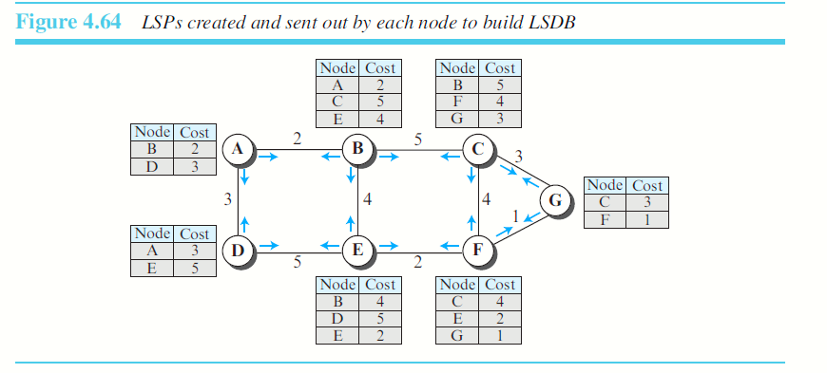
In the distance-vector routing algorithm, each router tells its neighbors what it knows about the whole internet; in the link-state routing algorithm, each router tells the whole internet what it knows about its neighbors.

Slide 22
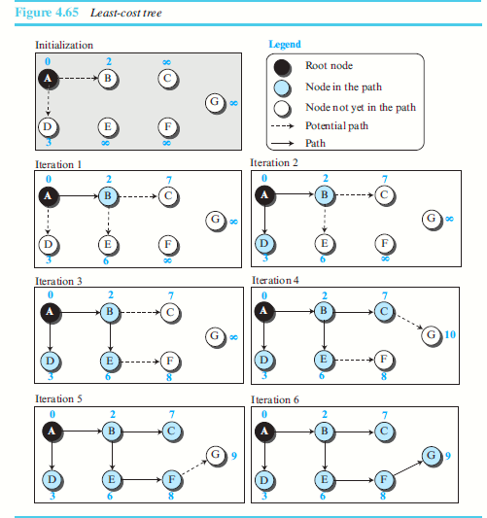

Slide 23
PATH VECTOR ROUTING
Link-State and Distance-vector routing are based on the least-cost goal.
Assume that there are some routers in the internet that a sender wants to prevent its packets from going through.
Goal of routing is reachability: to allow the packet to reach its destination more efficiently without assigning costs to the route.
The best route is determined by the source using the policy it imposes on the route. In other words, the source can control the path.

Slide 24
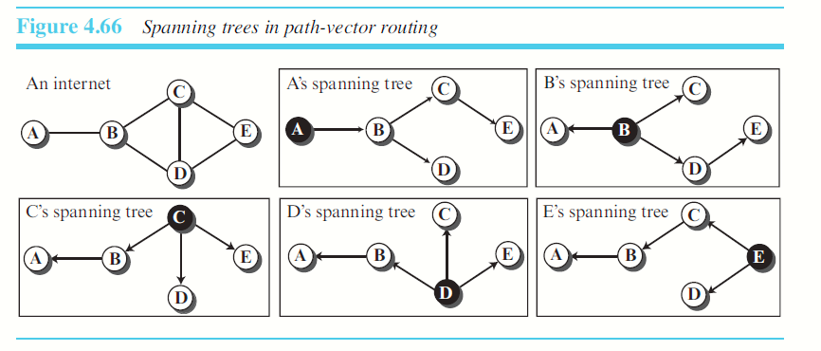

Slide 25
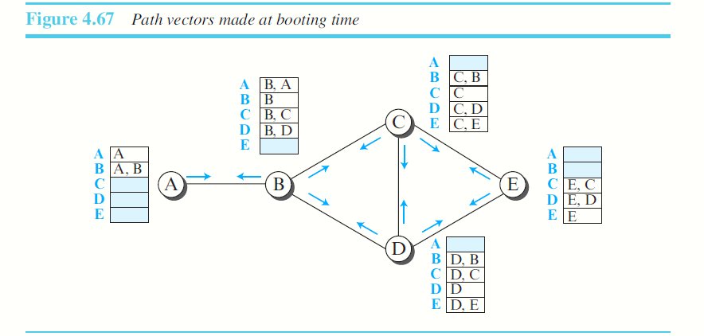
When a node is booted, it creates a path vector based on the information it can
obtain about its immediate neighbor
A node sends greeting messages to its immediate neighbors to collect these pieces of information

Slide 26
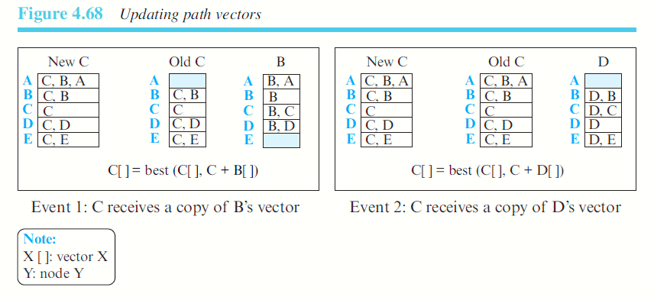

Slide 27
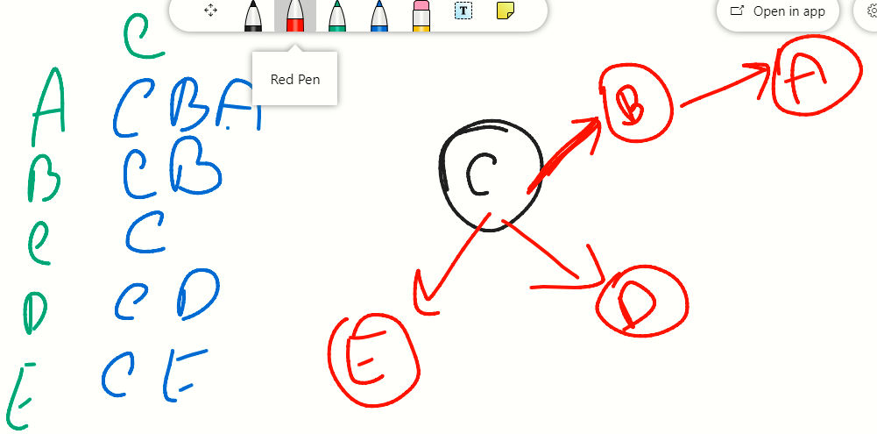

Slide 28
